Slide 1
Shape Factor in the R-C,
Increase in Residential Building Height, and Minor Lot Line Adjustment
Zoning Administration Division
Department of Planning and Zoning
5/12/16

Slide 2
R-C District Development #1
Lot 6 has a shape factor of 1,211.

Slide 3
R-C District
Development #2
Shape Factors are:
Lot 2 - 24
Lot 8A - 53
Lot 13A - 196

Slide 4
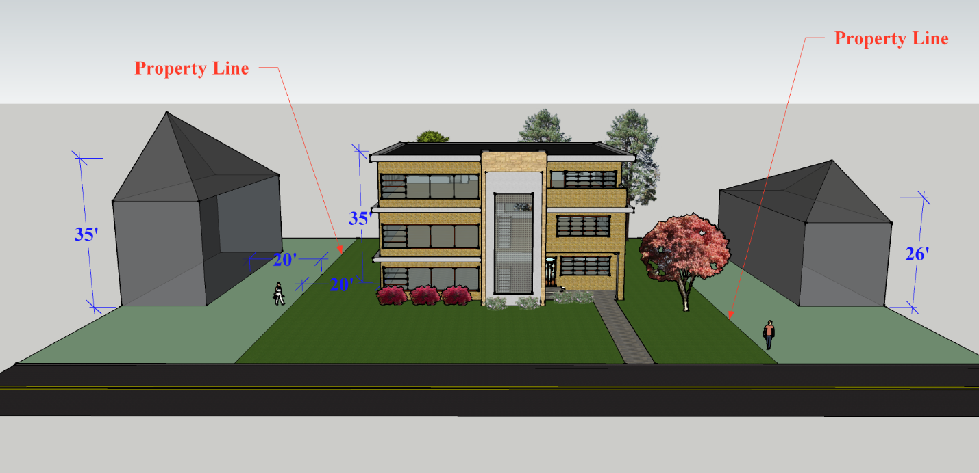
Building Height Illustration 1
35′ Tall Dwelling with 20′ Side Yard Setback

Slide 5
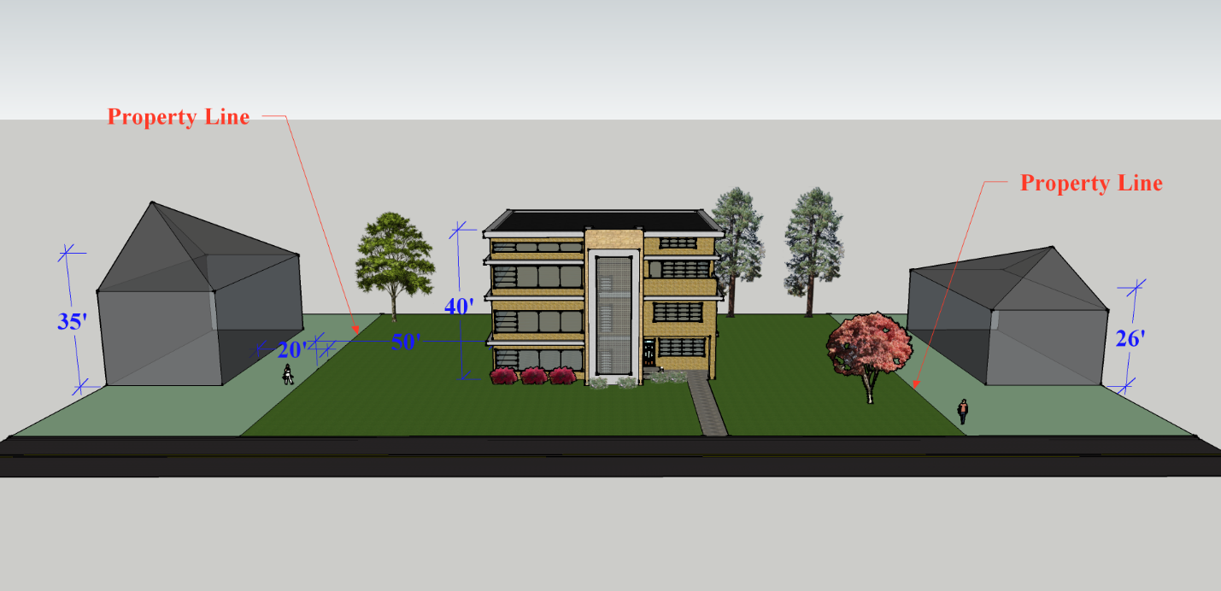
Building Height Illustration 2
40′ Tall Dwelling with 50′ Side Yard Setback

Slide 6
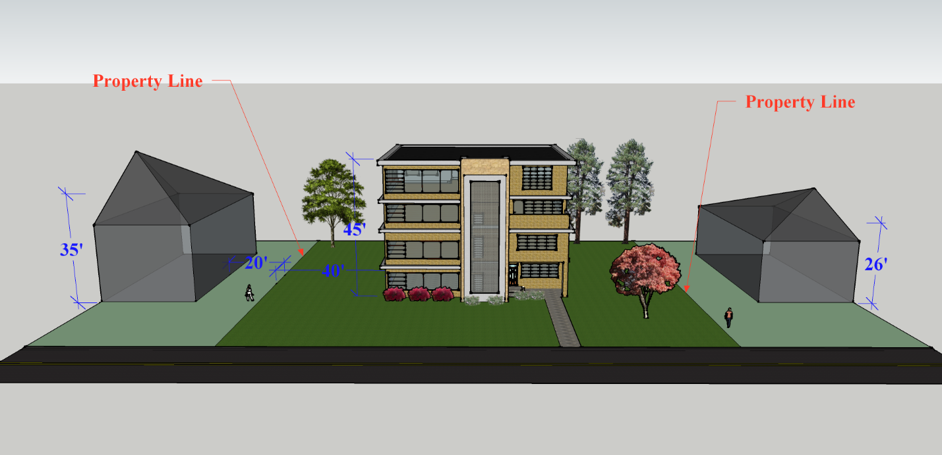
Building Height Illustration 3
45′ Tall Dwelling with 40′ Side Yard Setback

Slide 7
SECTION 2-405 LOTS

Slide 8
MINOR LOT LINE ADJUSTMENTS

