Slide 1
Sully District Council of Citizens Associations
January 25, 2017
Susan Shaw, P.E., Megaprojects Director
Virginia Department of Transportation

Slide 2
Transform 66: Outside the Beltway

Slide 3
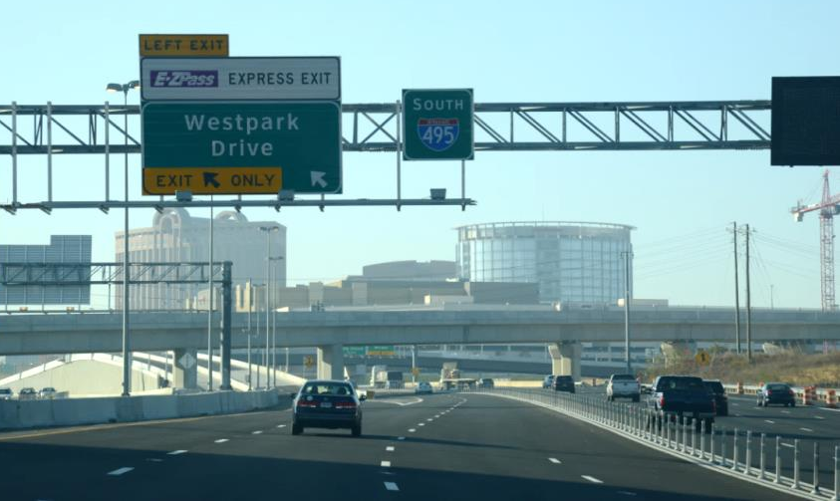
Project Scope
Multimodal improvements to 22.5 miles of the I-66 Corridor
2 express lanes in each direction from I-495 (Capital Beltway) to Gainesville (University Boulevard)
3 general purpose lanes in each direction
New transit service and park-and-ride lots
Safety and operational improvements at key interchanges

Slide 4
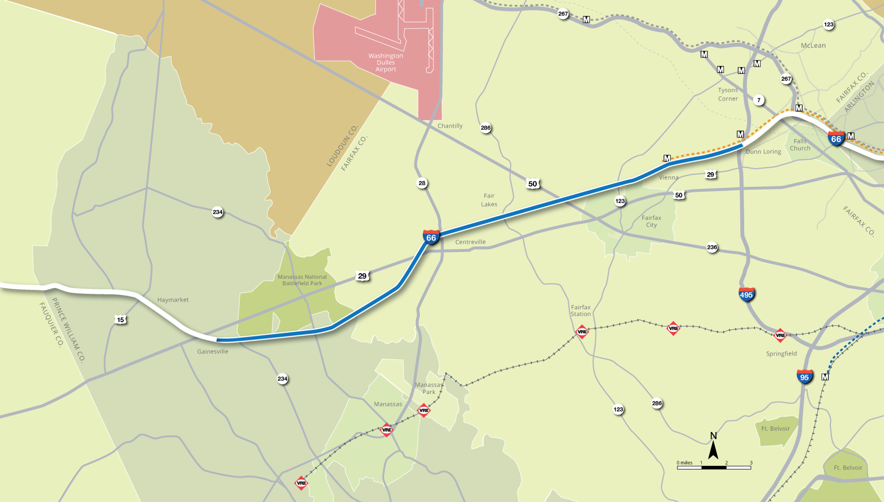
Project Map

Slide 5
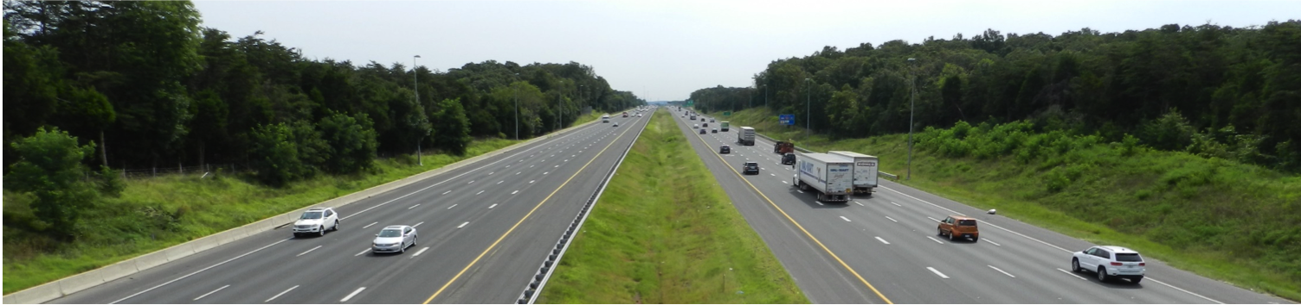
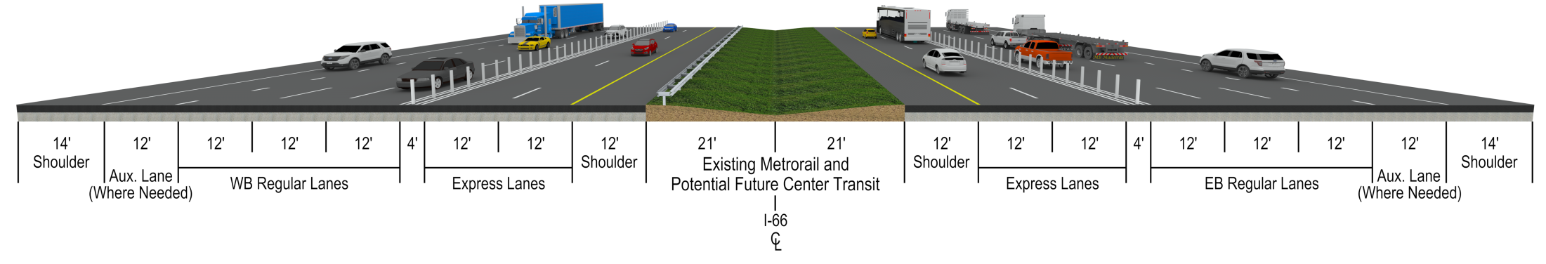
Cross Section
Gainesville to Manassas, Centreville to Beltway

Slide 6
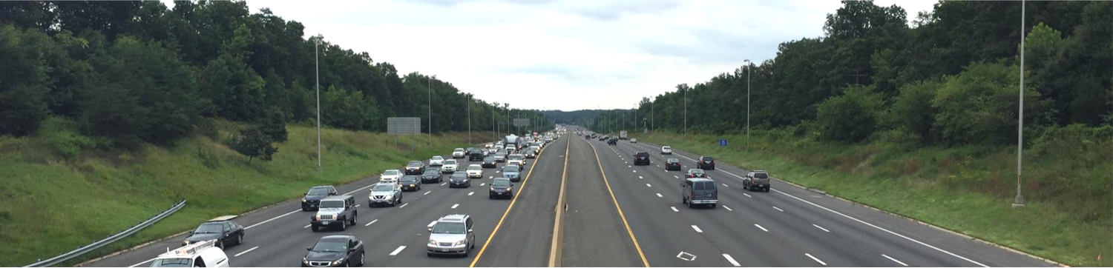
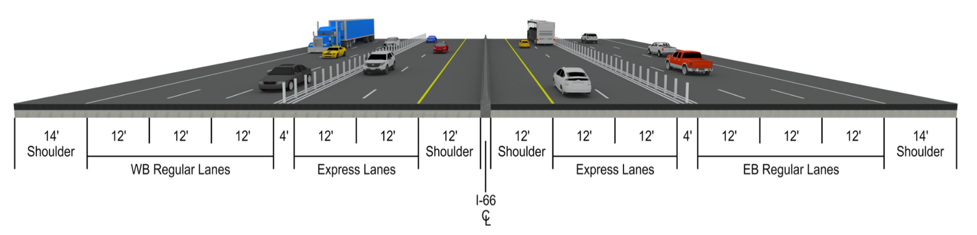
Cross Section
Manassas to Centreville

Slide 7
Key Policy Considerations
Funding for transit is a requirement
Developer retains the risks for:
  Excessive HOV use
  Limited relief for alternative facilities
Alternative Technical Concepts (ATC) desired
  Emphasis on innovation and increasing value
  Reduced scope or cheaper quality not acceptable
Minimize negative impact of construction activities
  Expedited construction schedule with Liquidated Damages (LDs) for late Project completion
  Liquidated damages for lane closures
No Notice to Proceed (NTP) for construction until the necessary permits are obtained

Slide 8
Key Business Terms
Concession Term: 50 years
Financing:
  Developer to finance the Project at its own cost and risk
  VDOT to provide up to $600 million public contribution
Permits:
  VDOT to obtain required NEPA approvals, CTB approvals, and approvals by FHWA of the Comprehensive Agreement and Project Management Plan, as necessary
  Developer to be responsible for obtaining all other permits and government approvals, and to reobtain any required reevaluation of NEPA approvals as a result of Developer’s ATCs
Design and Construction
  Fixed priced contract
Operation and Maintenance (O&M)
  Developer to be responsible for O&M of the express lanes, except for snow and ice removal, which will be done by VDOT
  VDOT to be responsible for operation and maintenance of the general purpose lanes

Slide 9
Preferred Proposer
Best value proposal
Express Mobility Partners
  Equity Investors
    Cintra Global LTD, Meridiam Infrastructure North American Fund II
  Design-Build Contractors
    Ferrovial Agroman US Corp, Allan Myers VA, Inc.
$2.3 billion construction project
Provides required transit payments and support of corridor improvements
Will make concession fee payment ($500M) to Commonwealth
Construction design provides innovative solutions to improve the physical quality and operations of the project

Slide 10
Other Benefits to the Commonwealth
$300M will return to the Northern Virginia Transportation Authority for other key regional projects
$300M will return to the High Priority Project Program in SMART SCALE for statewide competition
$500M now available for additional improvements to the I-66 Corridor subject to VA Code requirements
(§33.2-1528)

Slide 11
Future Milestones
Milestone | Dates and Schedule
Begin Final Design | January 2017
Design Public Hearing | September 2017
Begin Construction | Fall 2017
Right of Way Acquisition – Offers, etc. | October 2017 – December 2018
Park and Ride Milestone Date (960 Parking Spaces near Gainesville) | March 2019 Subject to NTP for Construction
Route 28 Signalization Date (Remove 4 Traffic Signals from Route 28) | February 2020 Subject to NTP for Construction
Begin Tolling (Service Commencement Date) | July 2022 Subject to Liquidated Damages
Project Completion Date | August 2022 Subject to Liquidated Damages

Slide 12
Planned Outreach and Coordination

Slide 13
Route 28 Interchange
2015 Traffic Volumes
Total Traffic Utilizing the interchange
  Route 28 Through Traffic Northbound and Southbound
  Ramps from I-66 to Route 28
  Ramps from Route 28 to I-66
AM Peak Hour = 8,450 vehicles per hour
PM Peak Hour = 9,500 vehicles per hour

Slide 14
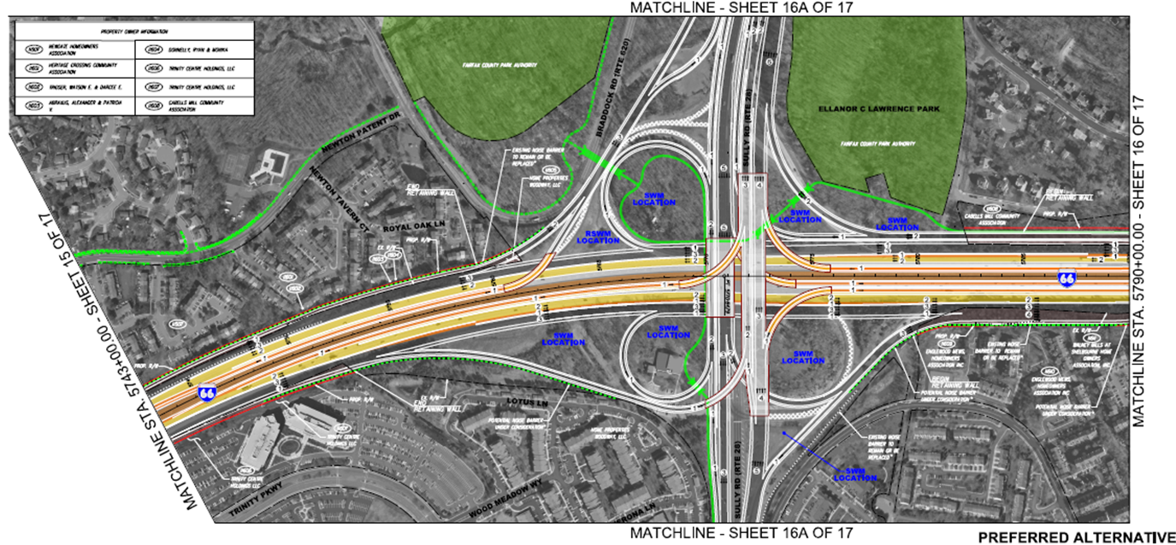
Route 28 Interchange

Slide 15
Route 28 Interchange –
Braddock Rd / Walney Rd

Slide 16
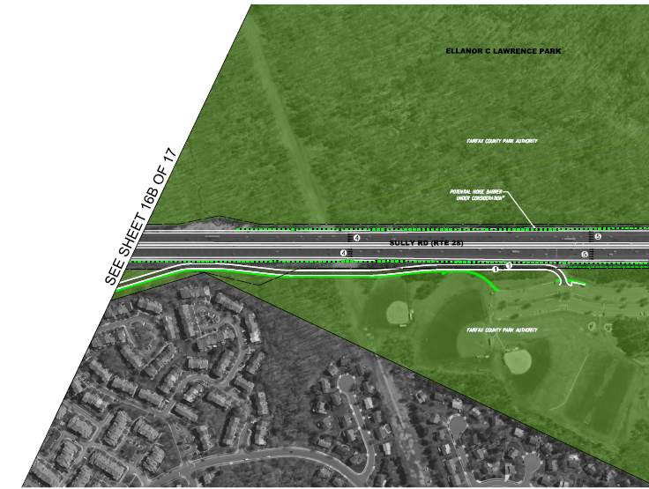
Route 28 Interchange –
Poplar Tree Rd Overpass / Park Access Rd

Slide 17
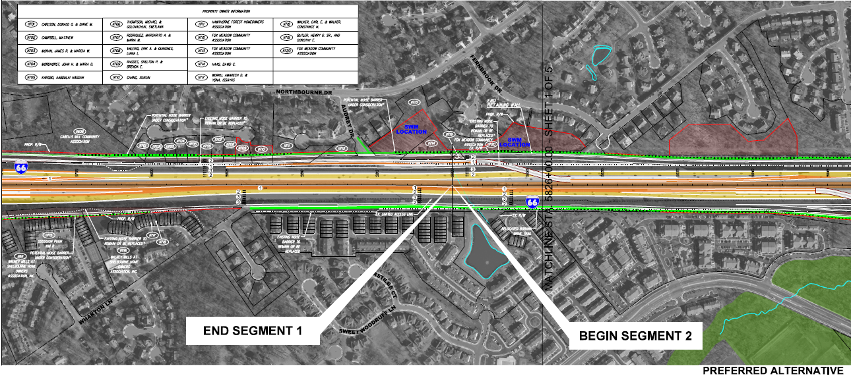
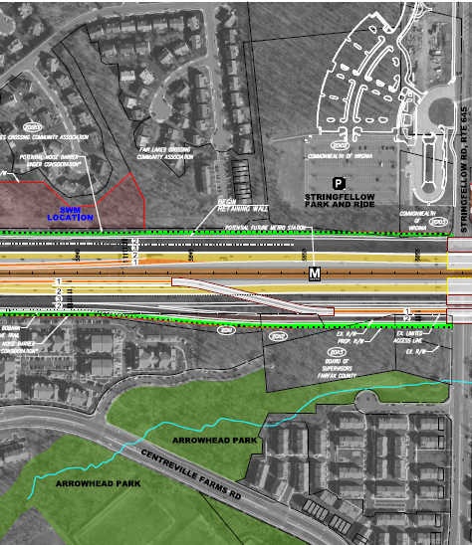
Route 28 Interchange –
East Leg

Slide 18
Route 28 Interchange Improvements
Retains existing movements between Route 28 and I-66 general purpose lanes
Adds critical access points between Route 28 and new express lanes on I-66
Removes all four existing traffic signals between Westfields and I-66 along Route 28
Relocates access to EC Lawrence Park from Route 28 to Stonecroft Boulevard

Slide 19
Transform 66: Inside the Beltway

Slide 20
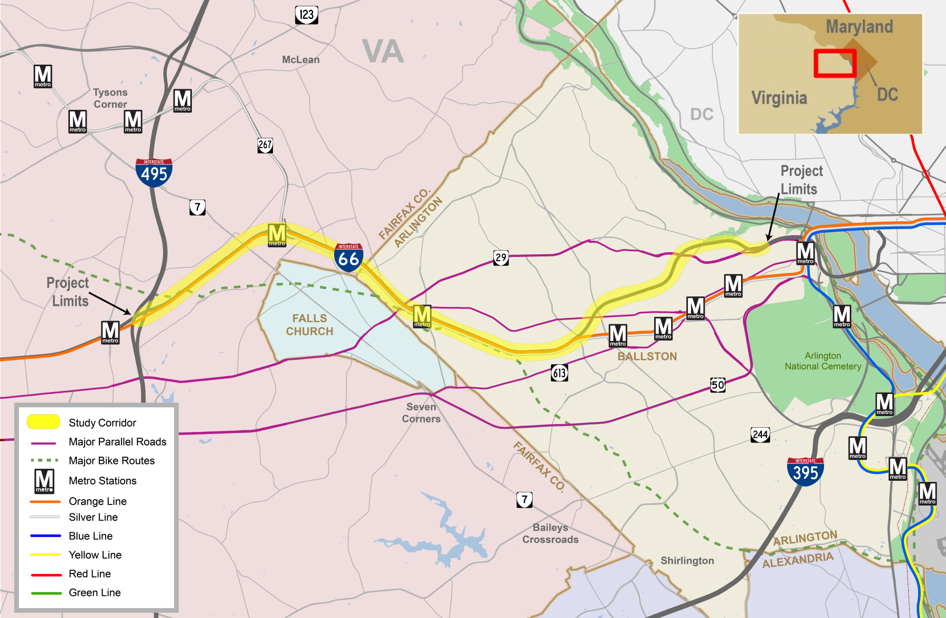
Program Area Map

Slide 21
Program Scope
Tolling during weekdays, peak hours, peak directions
  Eastbound: 5:30 a.m. – 9:30 a.m.
  Westbound: 3:00 p.m. – 7:00 p.m.
  HOV2+ toll free in 2017, HOV3+ toll free when Express Lanes open on I-66 outside the Beltway
  All vehicles using the lanes during tolling periods must have an E-ZPass or E-ZPass Flex, if they are HOV, mounted in vehicle
Multimodal improvements benefitting the I-66 Corridor funded by toll revenue
Widening of I-66 eastbound between the Dulles Connector Road and Fairfax Drive-Exit 71 (approximately 4 miles)
  Preparing an Environmental Assessment
  Conducting a Noise Analysis to determine locations of noise walls
  Tolling will continue through construction

Slide 22
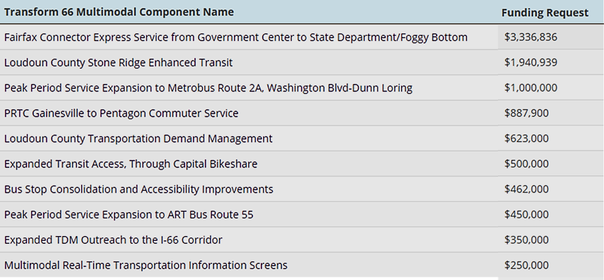
Multimodal Components Update
Commonwealth Transportation Board approved 10 projects totaling $9.8 million in July 2016
Projects are expected to be operational by the time tolling begins in 2017
Approved projects include:
underway

Slide 23
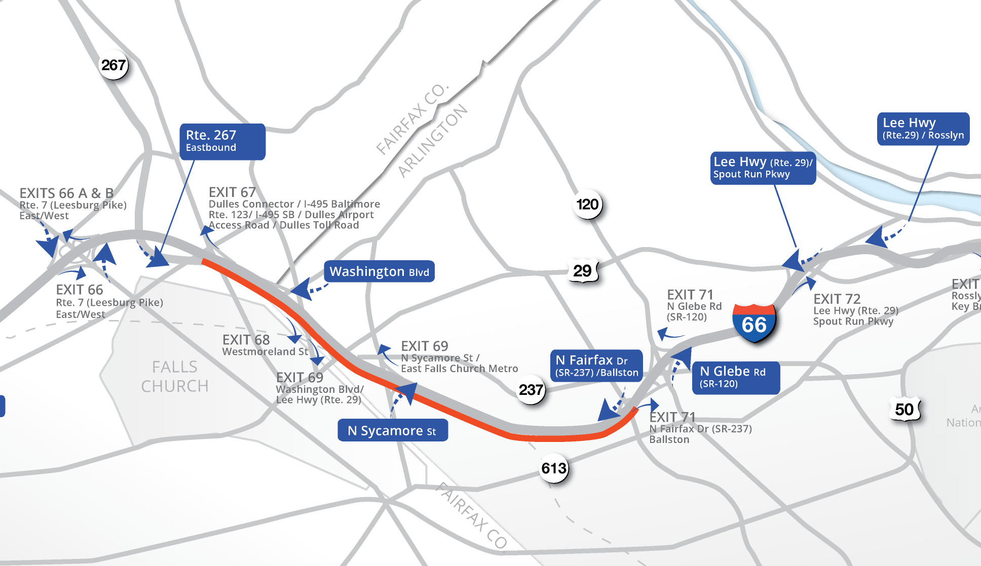
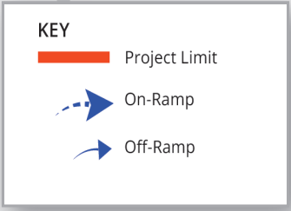
Eastbound Widening Map

Slide 24
Eastbound Widening
Project Schedule
Activities | Dates
Revised Environmental Assessment and Federal Highway Administration Decision | Early 2017
Begin Tolling and Implement Initial Multimodal Projects | Mid 2017
Award Design-Build Contract | Late 2017
Begin Construction | Mid 2018
Open New Eastbound Lane | Mid 2020

Slide 25
THANK YOU
Transform66.org
25

