Slide 1
SULLY COMMUNITY CENTER
Project Update
July 15, 2019

Slide 2
SULLY COMMUNITY CENTER
Agenda
Site Update
Building Design Update
Project Status & Community Outreach
Estimate & Schedule
Building Design and Construction Division

Slide 3
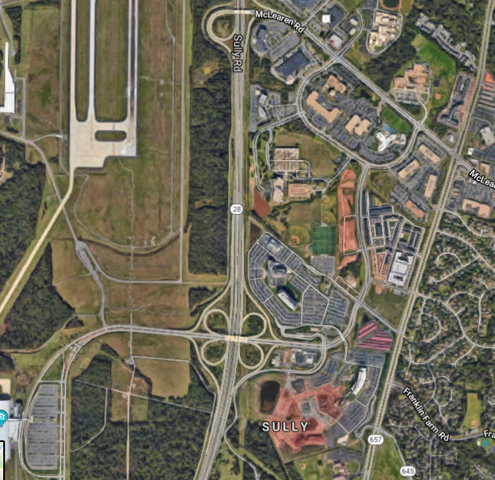
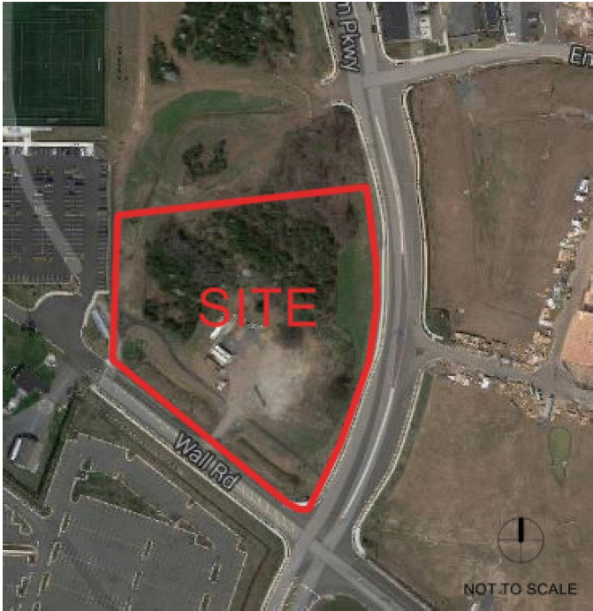
SULLY COMMUNITY CENTER
Site Location
5 acre site
Located:
13800 Wall Road, Herndon VA 20171
Air & Space Museum Parkway
Wall Road
Building Design and Construction Division

Slide 4
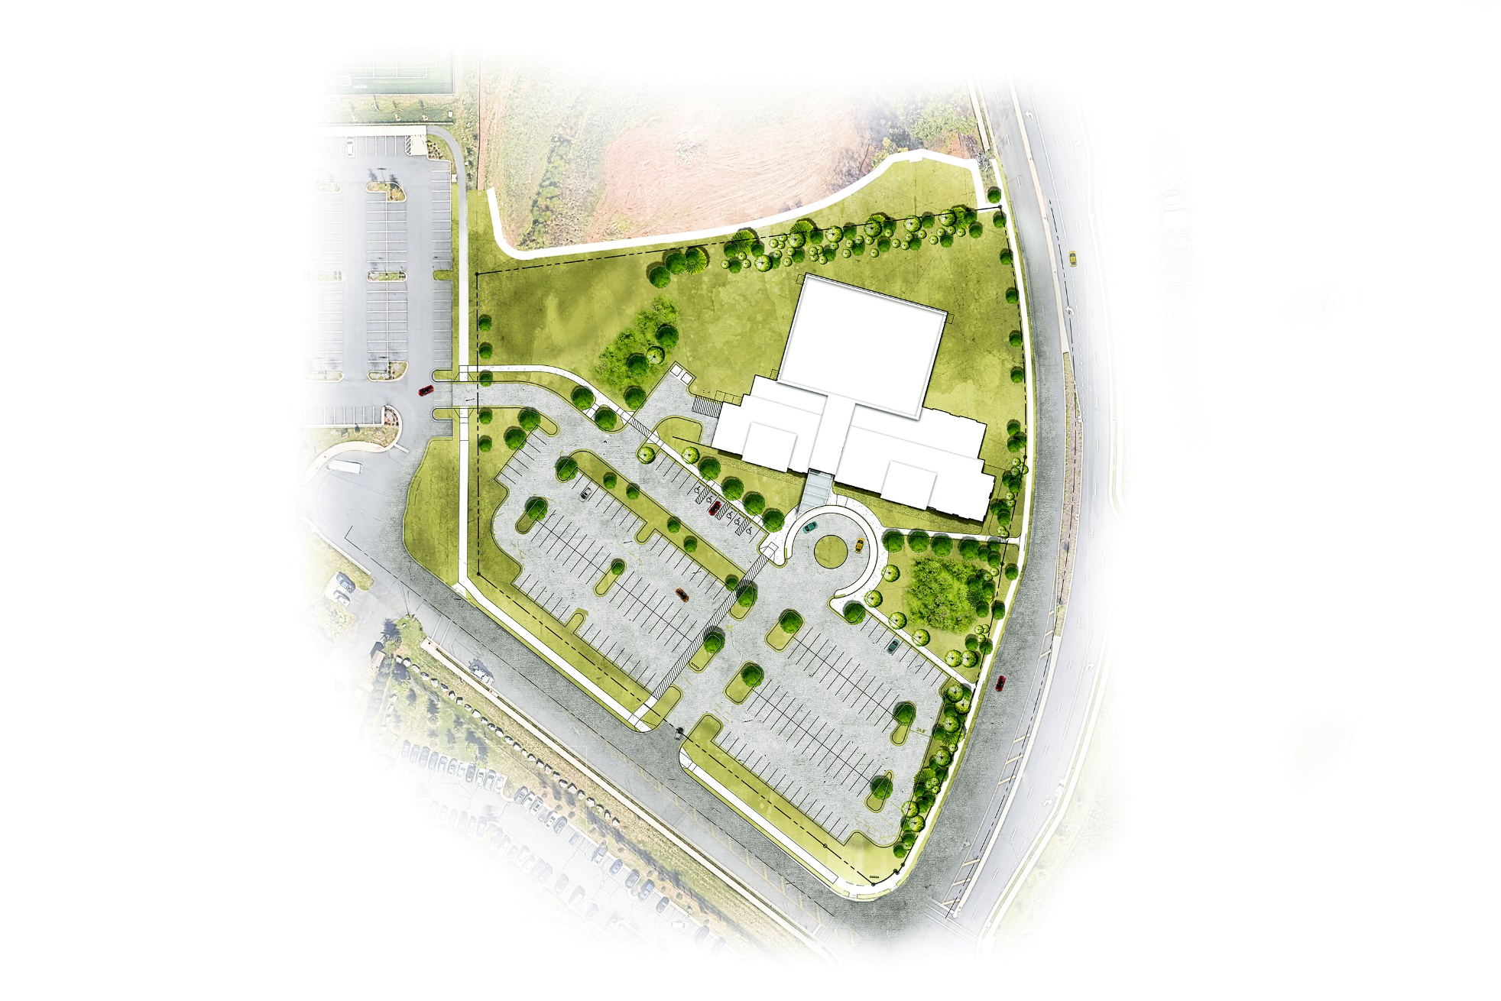
SULLY COMMUNITY CENTER
Original Site Design
5-Acre Site
Approx. 32,000 SF Building
Drop-off Area
Access from Wall Road
Air & Space Museum Parkway
Wall Road
Building Design and Construction Division

Slide 5
SULLY COMMUNITY CENTER
Site Revision Highlight
Air & Space
Museum Parkway
Air & Space
Museum Parkway
Wall Road
Wall Road
Additional Approx. 4,000 sf
Building Rotation
Building Design and Construction Division

Slide 6
SULLY COMMUNITY CENTER
Updated Site Design
Approx. 36,000 SF Building
(w/Health Suite)
Preserved wooded area
Enhanced Stormwater Management
Air & Space Museum Parkway
Wall Road
Building Design and Construction Division

Slide 7
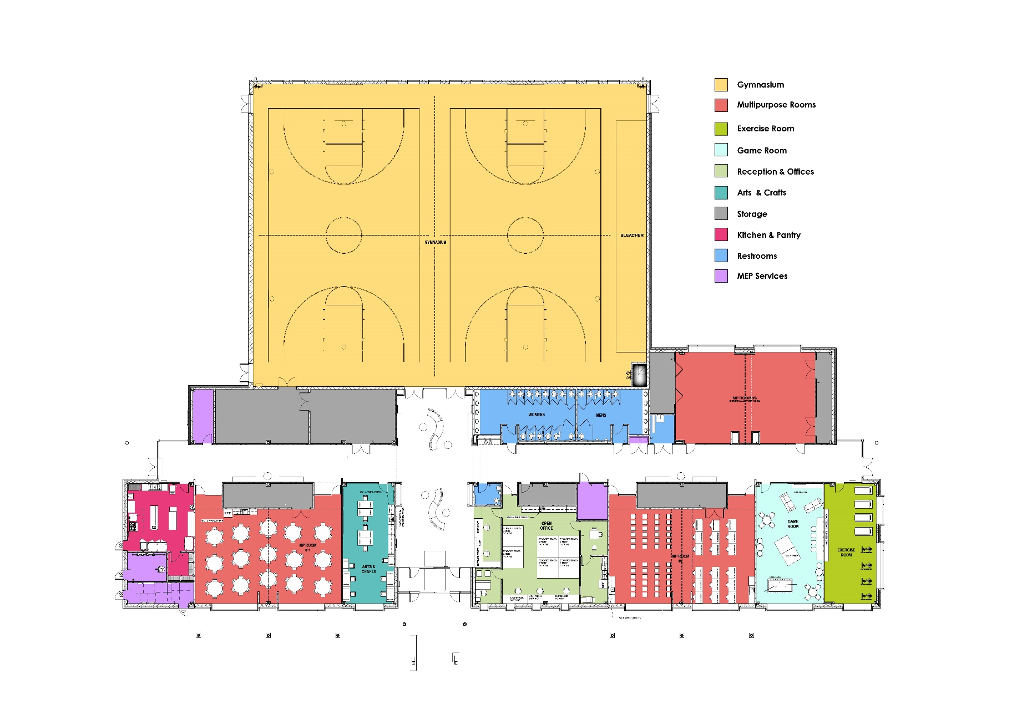
SULLY COMMUNITY CENTER
Original Building Design
Flexible Design to Accommodate Current & Future Community Needs
2 Courts
3 Multi-purpose Rooms
Arts & Craft Room
Game Room
Exercise Room
Gymnasium
Multipurpose
Room
Multipurpose
Room
Lobby
Multipurpose
Room
Building Design and Construction Division

Slide 8
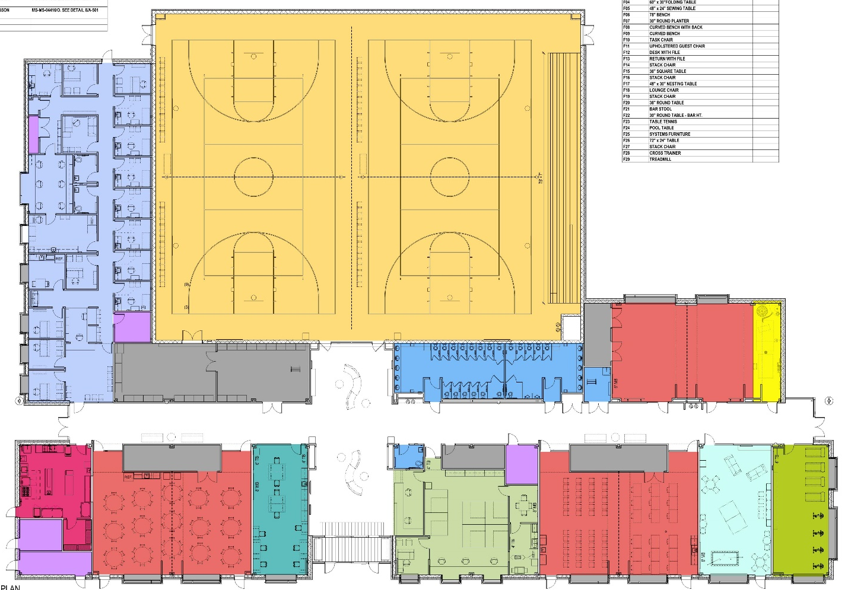
SULLY COMMUNITY CENTER
Updated Building Design
Flexible Design to Accommodate Current & Future Community Needs
2 Courts
3 Multi-purpose Rooms
Arts & Craft Room
Game Room
Exercise Room
Sensory Space
Healthcare Suite Addition
Gymnasium
Healthcare
Suite
Sensory Space
Healthcare Suite
Multipurpose
Room
Sensory
Multipurpose
Room
Lobby
Multipurpose
Room
3,800 sf Healthcare Suite Shared by HealthWorks & Women Infant & Children (WIC)
Building Design and Construction Division

Slide 9
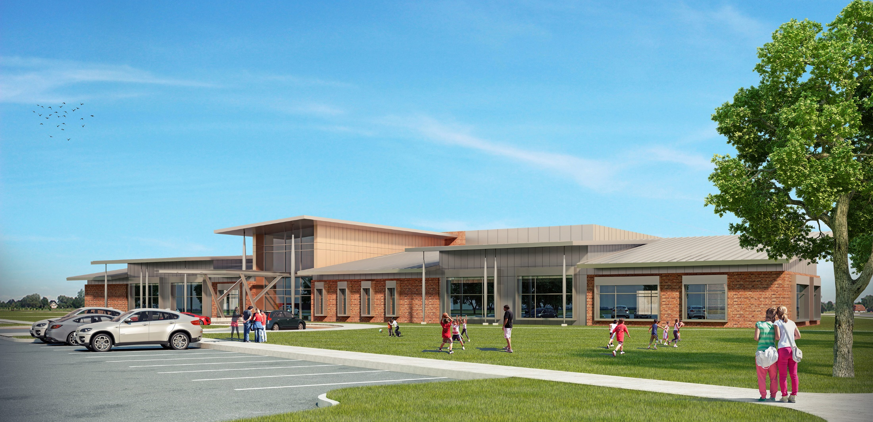
SULLY COMMUNITY CENTER
Building Design
Building Design and Construction Division

Slide 10
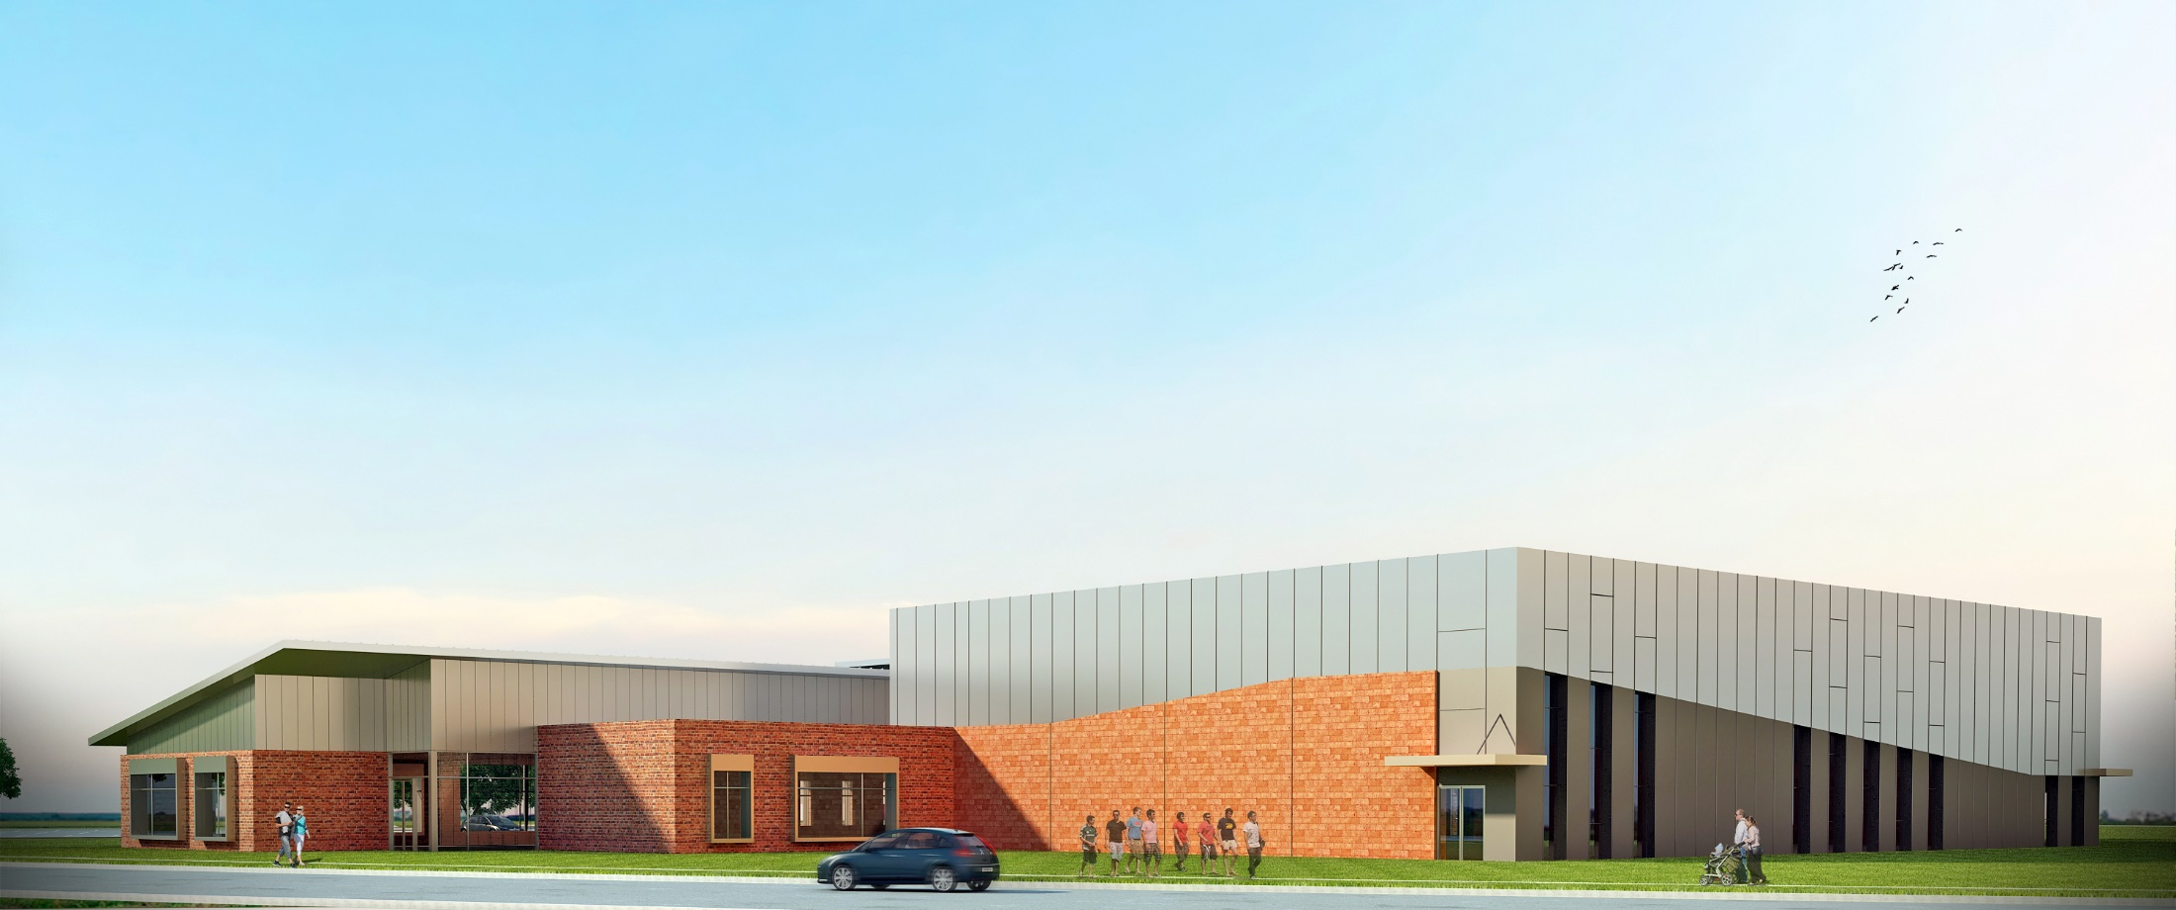
SULLY COMMUNITY CENTER
Building Design
Building Design and Construction Division

Slide 11
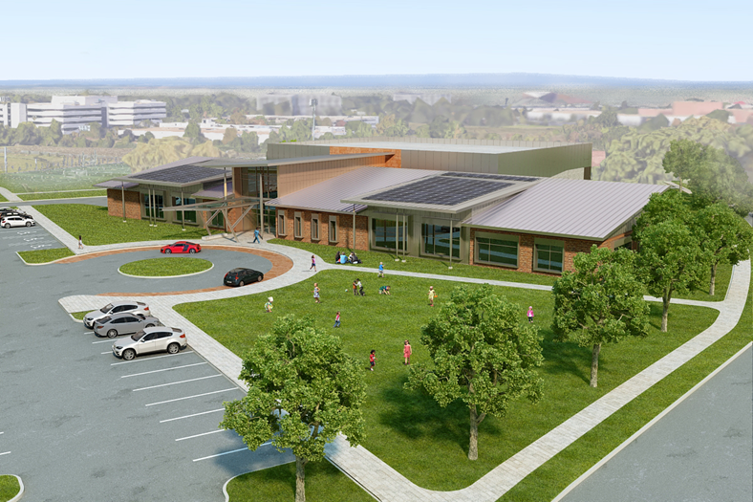
SULLY COMMUNITY CENTER
Building Design
Building Design and Construction Division
Notes:
Design:
Architectural design description:
Massing
Roof design
Drop-off area
Changes in height and material in line with the neighboring architectural style
Provide Flexible Design to Accommodate Current and Future Community Needs
Focus on Multi-generations and Diverse Ability Groups
Provide Relevant Expanded Community Services
Approx. 30,000 SF Intergenerational Center
Required Parking & Site Infrastructure
LEED Certified Building
ADA Compliant Design
Programed Spaces Such As:
Large Flexible/Multipurpose Rooms
Gymnasium with 2 Courts
Fitness Studio
Game Room
Arts & Crafts Room
Commercial Kitchen, Administration Offices

Slide 12
SULLY COMMUNITY CENTER
Project Estimate & Schedule
Total Project Estimate: $20 Million + $1.9 Million
Schedule:
Next Steps:
Planning Commission Hearing Oct. 2, 2019
Permit Approvals (Site & Building)
Soft Ground Breaking Fall 2019
Construction Start Spring 2020
Kick-Off
Occupancy
Design/Zoning/Permits
Bid
Construction
Fall 2017
Fall 2019
Spring 2020
Summer 2022
Building Design and Construction Division

Slide 13
SULLY COMMUNITY CENTER
Q&A
Questions?
Building Design and Construction Division

