Slide 1
Sully District Council of Citizens Associations
December 16, 2020
Tom Biesiadny, Director
Fairfax County Department of Transportation

Slide 2
Tonight’s Topics
Impact of the Pandemic on Transportation
  Current
  Future
Project Updates
  Silver Line
  Silver Line Bus Service Plan
  I-66
  Route 28 (Fairfax County; Prince William County)
  Route 29
  Braddock Road
  Fairfax County Parkway
  Route 50
Loudoun County Proposal
  Route 50 Northern Collector Road
Questions and Answers

Slide 3
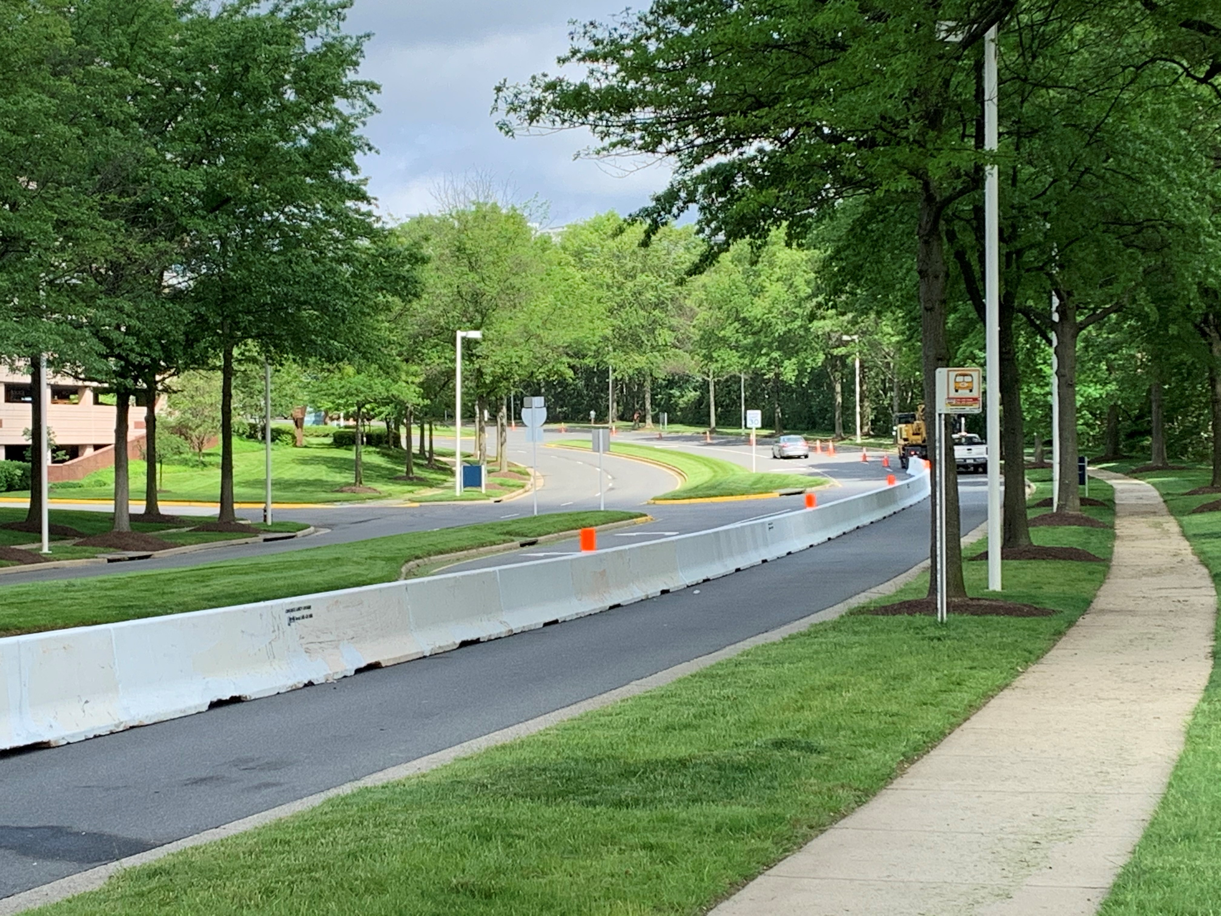
Impact of the Pandemic
Current
Transportation Demand Management
  Significant increase in telework
  Technology facilitated
  Limits to teleworking
Roadways
  Initially 40 to 50% drop in traffic
  Interstates: now only 10 to 20% below pre-pandemic; not as concentrated in peak
  Arterials: about 35% below pre-pandemic
  Trucks: fully recovered; in some cases exceeding pre-pandemic
Transit
  95% drop in rail ridership; still 80-85% below pre-pandemic
  70% drop in Fairfax Connector ridership; now -35% weekdays; -5% weekends
Bike and Pedestrian
  Increased significantly

Slide 4

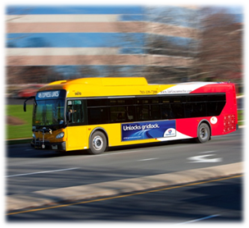
Impact of the Pandemic
Future
Transportation Demand Management
  Continued telework, but not five days a week
Roadways
  Likely to make a full recovery over time; peaks may be lower
Transit
  Rail transit and express bus will likely be slow to recover until vaccine is widely available
    Tied to recovery of office market
  Local bus will likely fully recover
Bike and Pedestrian
  Likely to see continued usage now that it’s been discovered/rediscovered

Slide 5
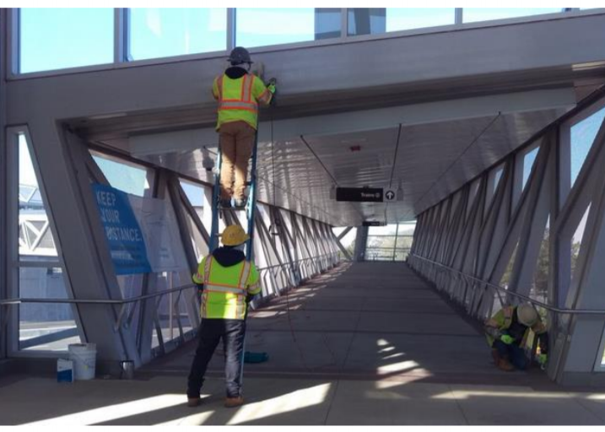
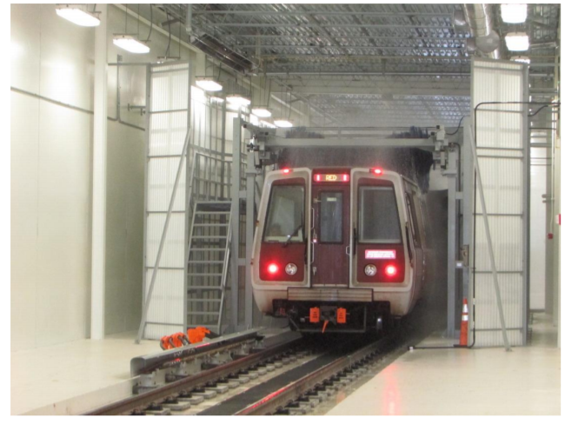
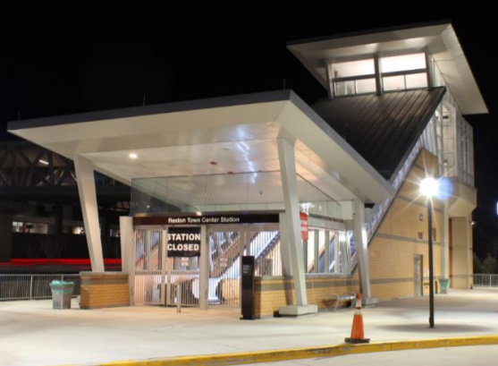
Silver Line Phase 2
Overall Phase 2 – 99% complete
General Activities
  Package A - Interior station finishes and clean up, touchup paving and roadway striping, dynamic testing, and final alignment of track and switches.
  Package B (Rail Yard) – Testing and commissioning, building punch lists, and software programming.
Timeline
  Package A (Rail, systems, stations) completion – Early 2021 (target)
  Package B (Yard) completion – Early 2021 (target)
  Metro Board to establish Revenue Operations Date
Touch-ups on
Pedestrian Bridge
In Reston
Train Wash
Testing
Reston Town Center
Station Entrance
Pavilion

Slide 6
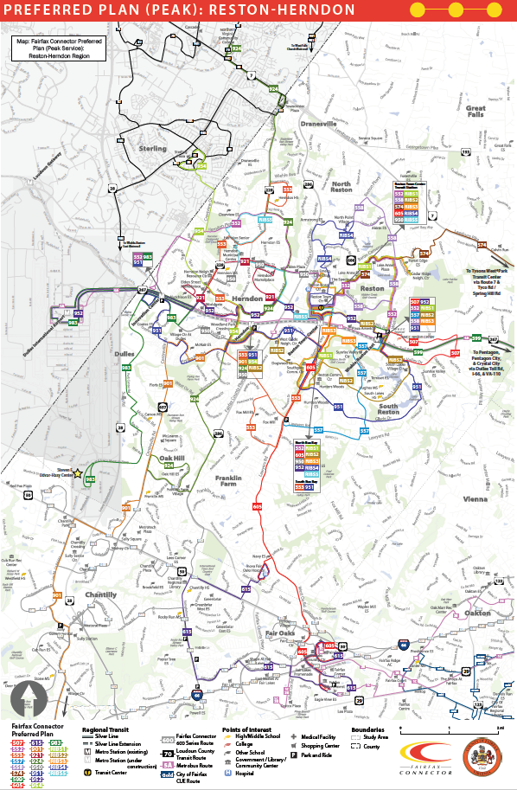
Silver Line Phase 2
Bus Service Plan
Loudoun County Routes
New connections and routes
  Chantilly / Centreville to Dulles Corridor
  Northern Virginia Community College (Loudoun Campus)
  Sterling to Herndon
Improves average frequency from 30 to 20 minutes
Improves span of service
Provides more direct connections
Shortens travel time
Increases access to transit reliant population and employment
Maintains bus stop coverage at most locations
Improves access to middle and high schools
Board consideration on March 9, 2021
Implementation with Silver Line

Slide 7
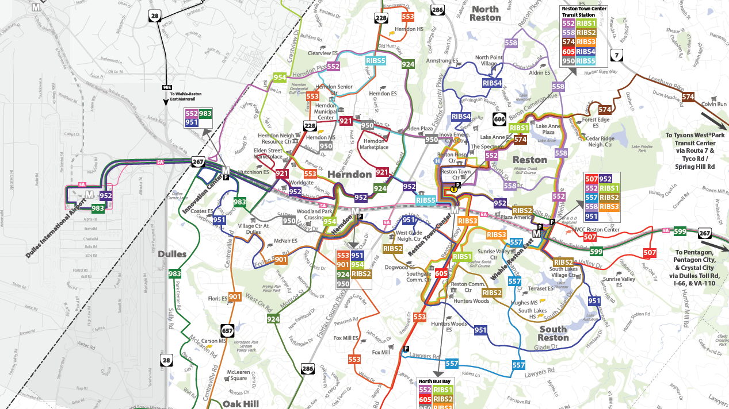

Slide 8
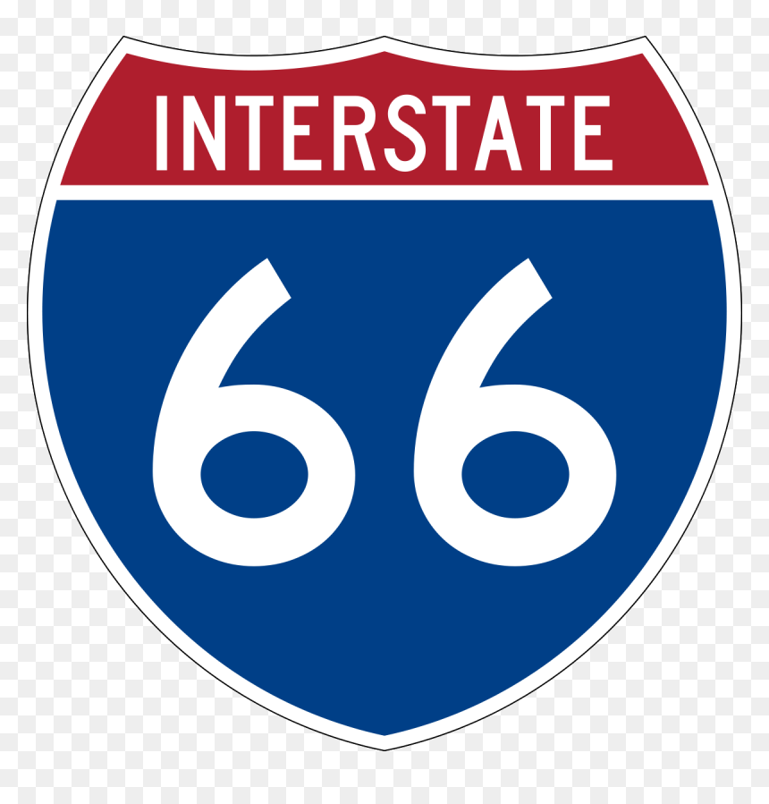
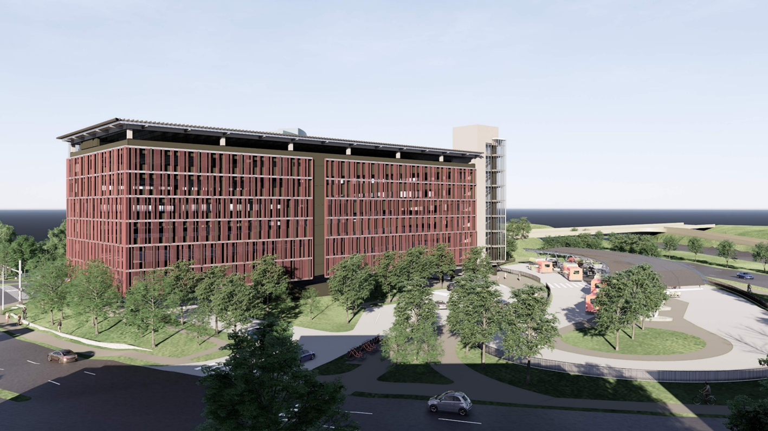
Project Updates
I-66
  Express Lanes Project (Route 15 to I-495)
  Eliminated remaining signals north of Route 29 in November 2020 (On schedule)
  Popular Tree Road Bridge Open
  Work continues on interchanges (Route 29, Route 28, Route 50, Route 123, Nutley Street and I-495) and mainline
  Work on Monument Drive Bridge has not started yet
  Numerous bridges over I-66 under construction
  I-66 Bridges over Route 29
  Parallel Trail
  Monument Drive Transit Center
  New bus services initiated; more in the future
  Target completion: end of 2022

Slide 9

Project Updates
Route 28 (Fairfax County)
  Construct an additional lane in each direction from just north of the bridge over Bull Run to the Route 29 Interchange
  Reconstruct sub-standard vertical alignment on SB Route 28 to meet current standards
    Compton Road to Bradenton Drive
    Just south of New Braddock Road
  Include Shared Use Paths
    Both Sides of Route 28
    Short Section of Sidewalk on SB side between Upperridge Drive and Machen Road due to Right-of-Way constraints
  $78.8 Million

Slide 10

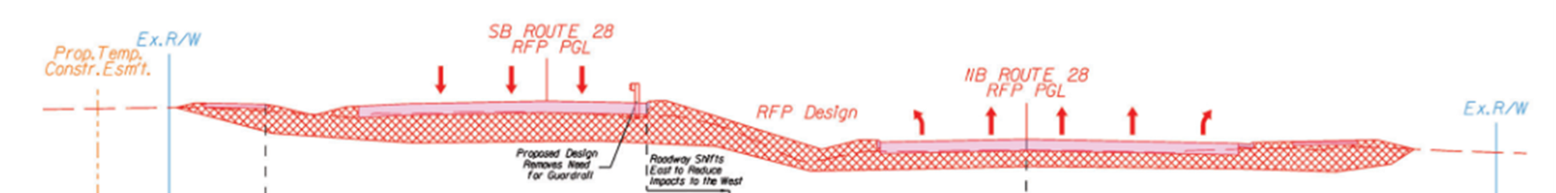




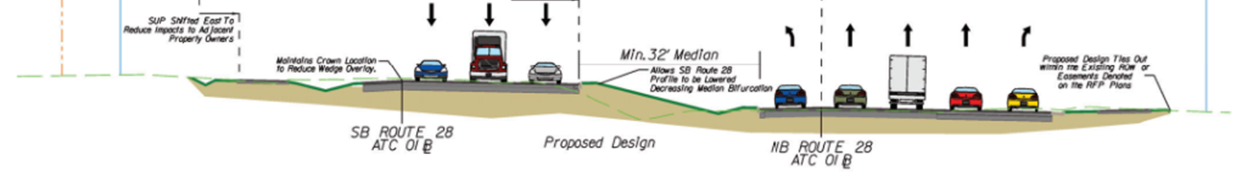
Project Updates
Route 28 (Fairfax County)

Slide 11
Project Updates
Route 28 (Fairfax County)
Design Public Hearing –
Final Environmental Document –
Award Design Build Contract -
Notice to Proceed -
Roadway Plans (60% Complete) –
Start ROW Acquisition (Total Acquisitions)
Start Temporary Roadway Widening -
Start Permanent Roadway Widening -
Substantial Completion –
Final Construction Completion –
September 23, 2019
October 30, 2019
May 26, 2020
June 15, 2020
October 12, 2020
November 2020
January 2021
Spring/Summer 2021
Spring 2023
Summer 2023

Slide 12
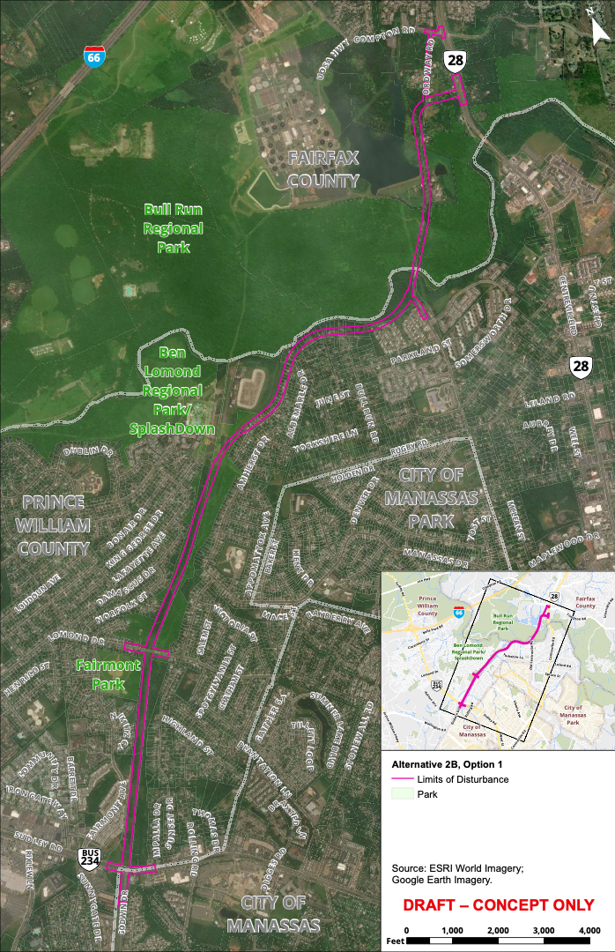
Route 28 Bypass
  Prince William Board of
  County Supervisors (BOCS) endorsed the Route 28 Bypass Option in
  September 2020

Slide 13
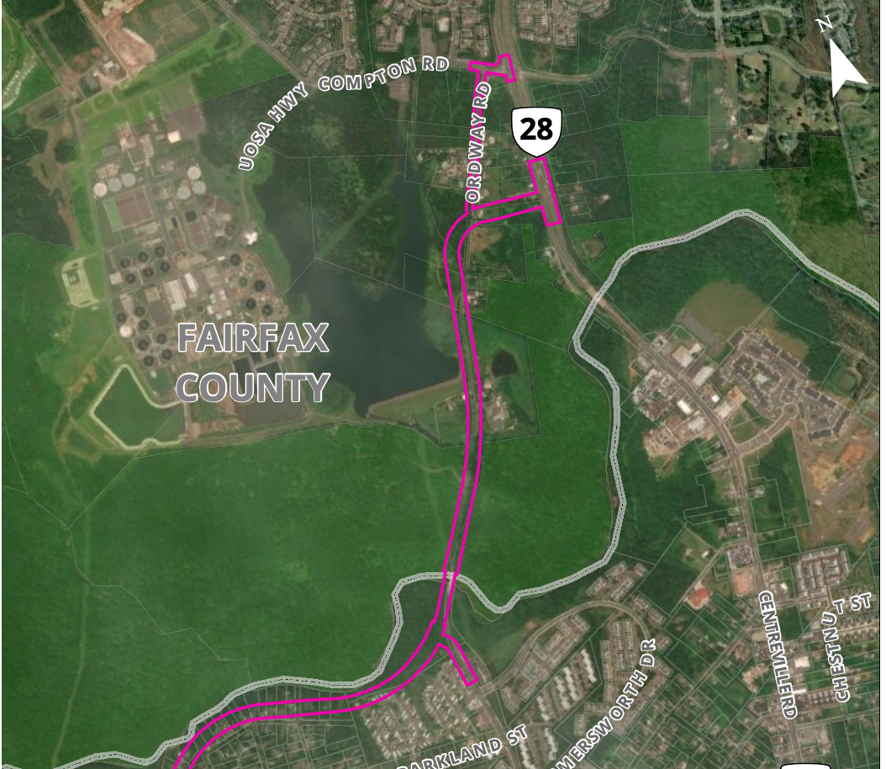
Route 28 Bypass Concept Location
  This represents the Route 28 Bypass corridor concept.
  The specifics of the corridor will be determined during the Design and Engineering Phase (Phase 2).
  The actual Bypass will have a smaller footprint than currently represented on this map.
DRAFT- CONCEPT ONLY

Slide 14
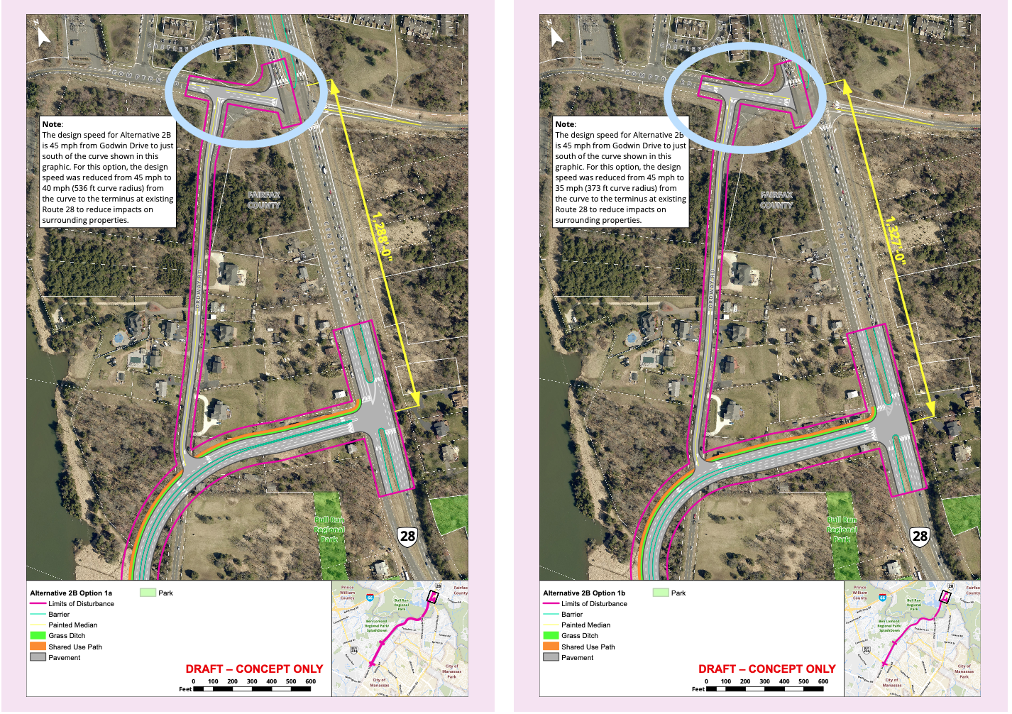
Zooming In on the Fairfax County Tie-in Point
Route 28 Bypass
Option 1A Terminus
Route 28 Bypass
Option 1B Terminus
  These represent some of the options for the Bypass terminus in Fairfax County.
  The specifics of the terminus will be determined during the Design and Engineering Phase (Phase 2).

Slide 15

Project Updates
Route 29
  Pickwick Road to Buckley’s Gate
  Widen from four to six lanes
  Bike and pedestrian facilities
  Address bifurcated roadway
  $85.9 M
  Land acquisition phase underway
  Utility Relocation: September 2021
  Construction Completion: Late 2023

Slide 16
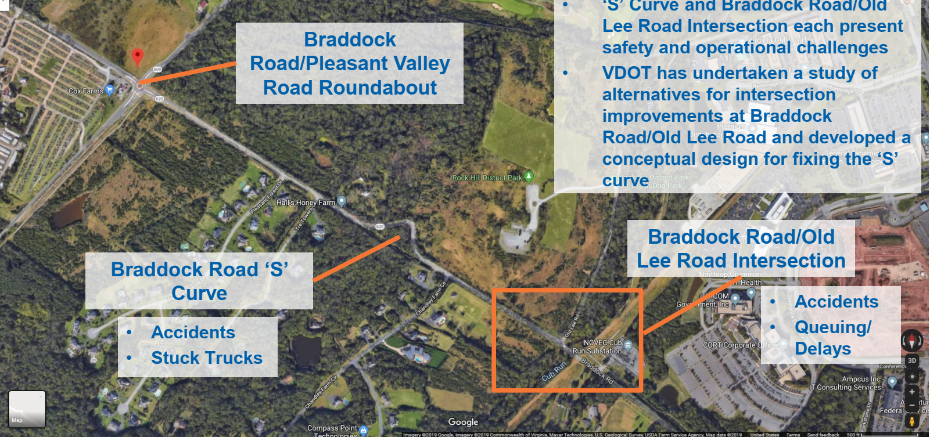
Project Updates
Braddock Road/Old Lee Road
  Intersection Improvement
  Address hazardous curve
  Add pedestrian facility
  Estimated Cost: $16 M; Funding application submitted to VDOT
  Funding decision: June 2021; Funding availability: July 2025

Slide 17
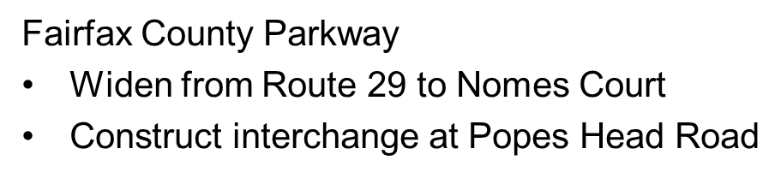
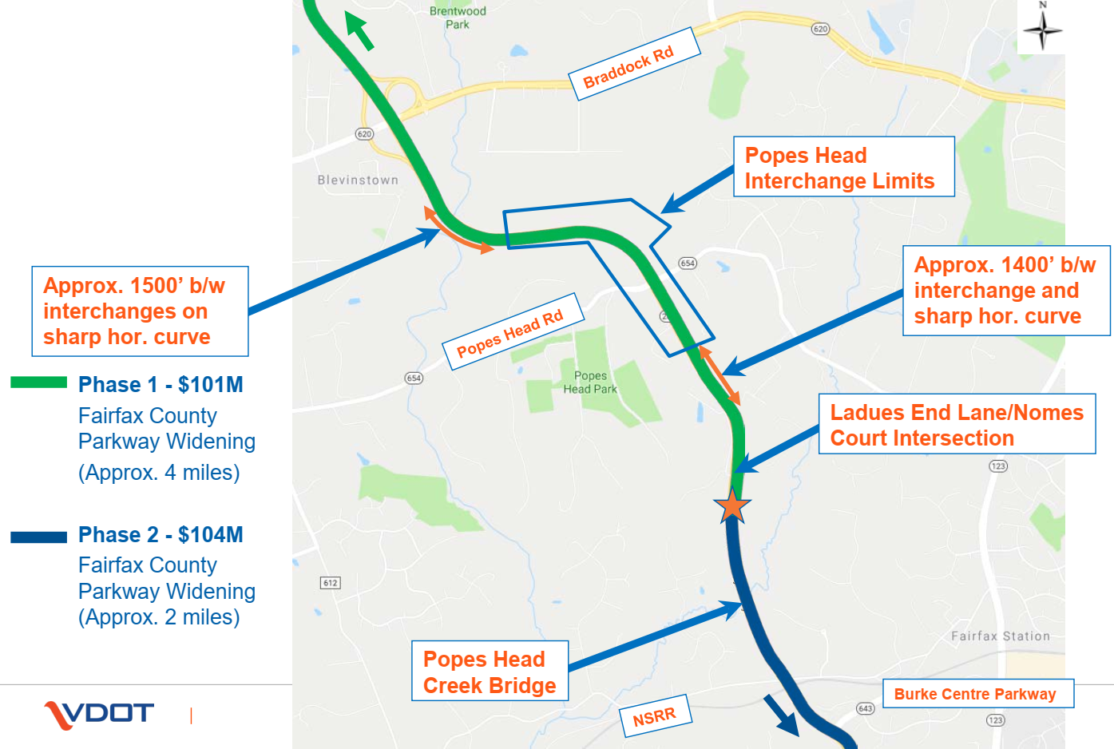
Project Updates

Slide 18
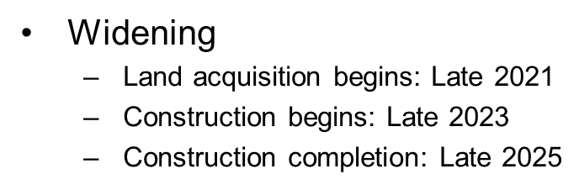
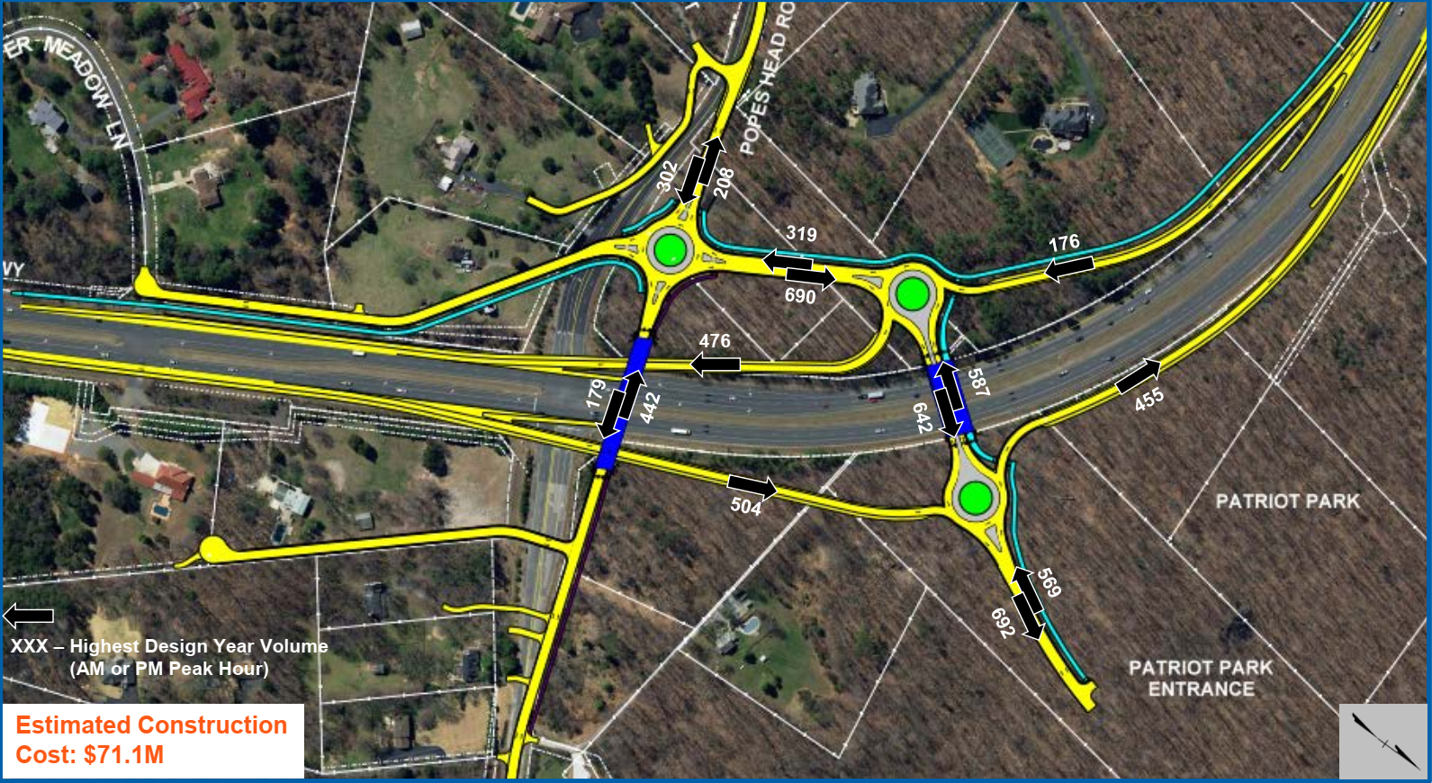
Project Updates
Fairfax County Parkway
Popes Head Interchange
  Land acquisition begins: Early 2021
  Construction begins: Late 2022
  Construction completion: Late 2024

Slide 19
Project Updates
Route 50
  VDOT conducted corridor study (Route 28 to Stringfellow)
  Intersection improvement recommendations
  Consideration for future funding requests

Slide 20
Loudoun County Proposal
Route 50 Northern Collector Road
  Tall Cedars to Route 28
  Estimated cost: $96.2 million
  Coordination required
    Fairfax County
    Metropolitan Washington Airports Authority
    Smithsonian
  Not in Fairfax County’s Comprehensive Plan
  Waiting for traffic analysis from Loudoun County

Slide 21
Questions?

